Slide 1
Global Agricultural Production and Population Analysis
Project 1
Corey Holton, Elena Gehle, Domenic Guerrero, and Roberta Chandler

Slide 2
Overview
Introduction
Background: This project analyzes global agricultural production relative to population data over time. It uses Python to process data on agricultural production by category, and country, as well as global and continental population data. The goal is to visualize trends and relationships between food production and population growth.
Purpose: Explain the significance of understanding the relationship between agricultural production and population.
Objective: To analyze how global agricultural production has changed relative to population over time, focusing on key agricultural products.
2. Research Questions
Key Questions:
How has the production of major agricultural products (e.g., meat, vegetables, grains) evolved over time?
How does agricultural production vary across different countries and continents?
What trends can be observed in the relationship between agricultural production and population growth?

Slide 3
Data collection, cleanup, and exploration
Following the selection of an area of focus, an extensive search was conducted to identify suitable datasets for agricultural production and global population data. Upon acquiring the datasets, they were imported into a notebook for initial examination. It was quickly identified that the agricultural data contained an excess of information, while the population data lacked complete yearly records. To address this gap, an additional population dataset was obtained and merged with the initial set to ensure alignment of time frames.
The datasets were then refined by removing non-essential columns and restructuring the data to fit the analysis objectives. To streamline the visualization process, data was aggregated at the continental level, given the large number of countries involved. Agricultural items were categorized according to predefined classifications. The final dataset was transformed into a time series format, facilitating statistical analysis and the creation of visual plots to illustrate trends.

Slide 4
Exploration of data
1. Aggregation
Production by Category and Continent: Aggregated production data at different granularities, such as yearly totals by category and continent. Explored averages, maximum, minimum, and sum statistics for different categories.
Top 5 Items by Country: Aggregate the data to identify the top-producing items for a given country (China example in slides).
2. Correlation Analysis
Production vs. Population Growth: Analyzed how the production of food changes with population growth. Used correlation coefficients (Pearson, Spearman) to assess the strength of these relationships.
Category Comparisons: Investigated correlations between different production categories within the same continent, e.g., if meat production increases with grain production.
3. Comparison Analysis
Continent Comparisons: Compare production trends across continents to see which continents have experienced the most growth or decline in specific agricultural categories.
Category Comparisons within Countries: Compared how different agricultural categories contribute to a country’s total production and how these have changed over time.
4. Summary Statistics
Yearly Production Summaries: Calculate mean, median, standard deviation, and quartiles for production data by category, to identify trends and anomalies.
5. Sentiment Analysis
Public Perception of Agriculture: We could see a fall in Europe’s agricultural production which makes since given the negative perception farmers impose to the environment in Europe have received over the past decade.
6. Time Series Analysis
Forecasting Production Trends: Utilize time series analysis with Prophet to forecast future production levels for specific categories, continents, or countries (if we have time)
Population vs. Production Over Time: Time series was plotted to show population vs agricultural production on a global scale to see how the trends interact over time. This data could be used to predict the future of both population growth and agricultural supply for the future, although it does lack the availability of predicting yields and available farmland.

Slide 5
Visualizations
Clear and accurate labeling of images (5 points).
Visualizations supported with ample and precise explanation (5 points).

Slide 6
Approach to Achieving Project Goals
The project approach emphasized staying on task, maintaining diligence, and making consistent daily progress until all tasks were completed. Tasks were clearly outlined in detail, providing a structured roadmap for the work ahead.
To address the research questions, data preparation was the initial focus, ensuring the datasets were suitable for analysis. With the prepared datasets, various graphs were generated based on the questions posed. Observations from these visualizations sparked further data exploration, leading to deeper insights.
Subsequently, efforts were directed towards assembling the README file, which was completed efficiently. The final step involved creating an outline for the presentation and incorporating key graphs to guide the delivery of this segment, ensuring a comprehensive and cohesive presentation.

Slide 7
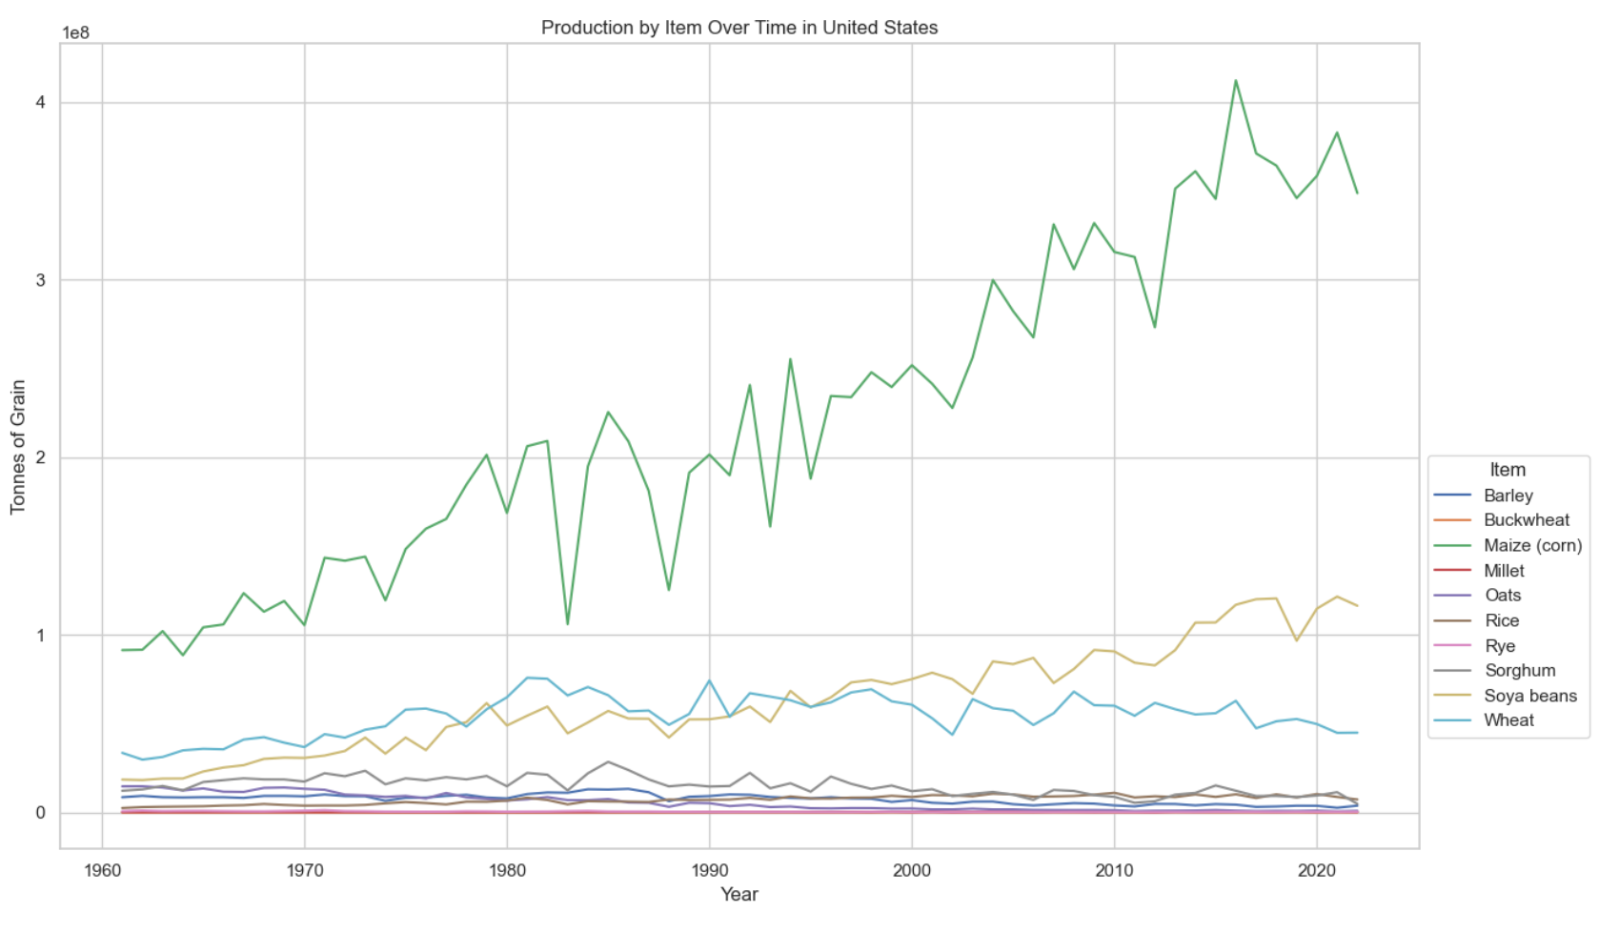
Plan for Future Development
Future development could focus on deeper analysis of honey production trends by country to determine if the observed decline is isolated to the U.S. or part of a broader global trend. Further exploration into the factors influencing corn production dips in the U.S. could also be prioritized, potentially examining climate data, such as drought occurrences. Expanding the data scope to include additional variables and investing in more time and resources for comprehensive analysis would be critical to uncovering the causes behind these observations.

Slide 8
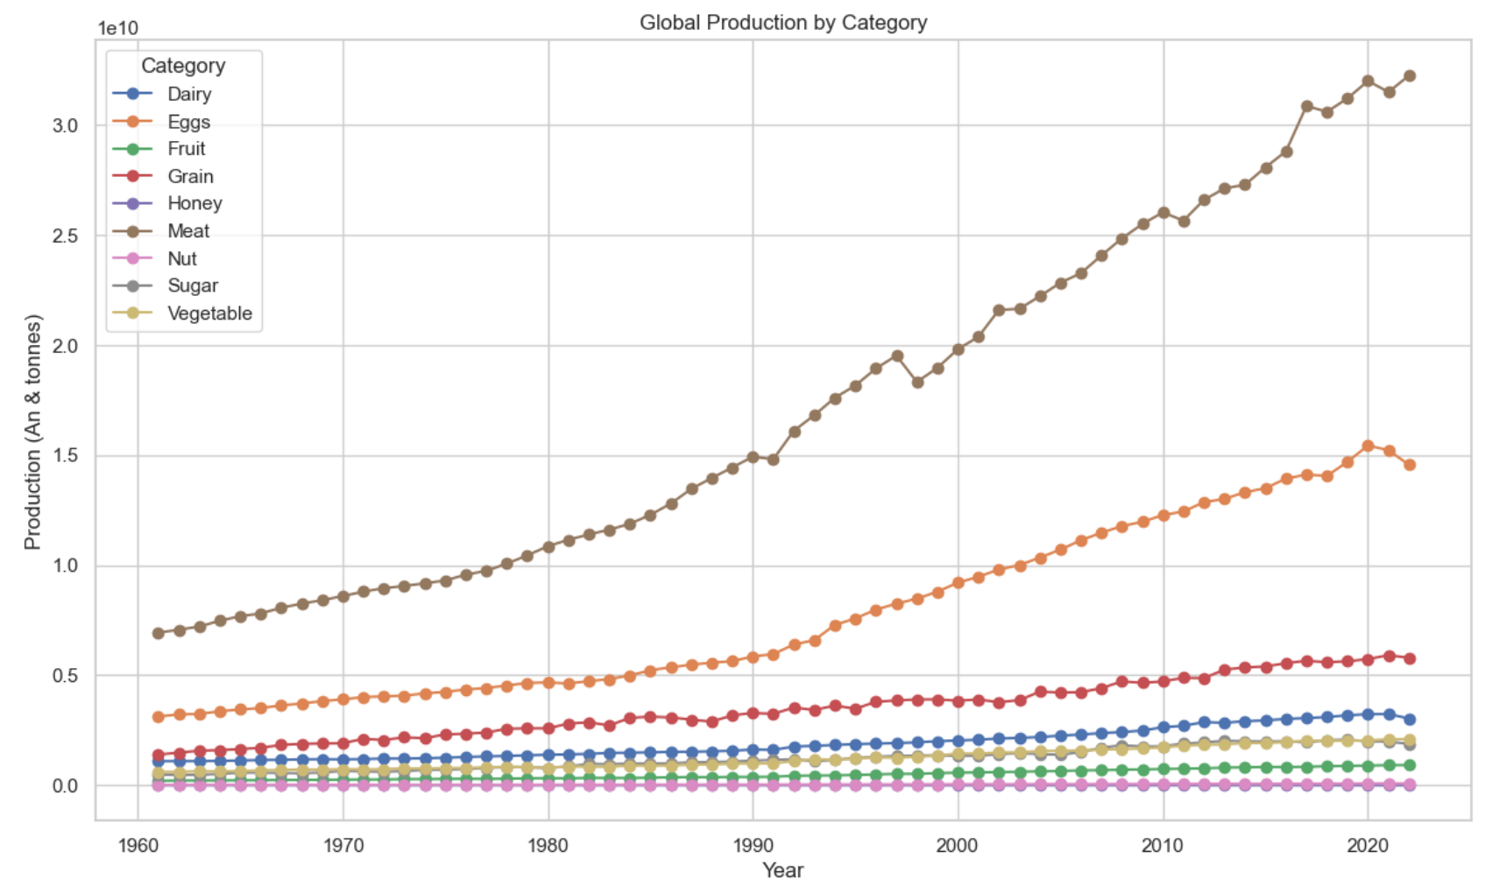
1. How has the production of major agricultural products (e.g., meat, vegetables, grains) evolved over time?
Key Findings:
Meat Production: Meat production showed the most significant increase globally, driven primarily by exponential growth in chicken production. Statistical analysis revealed that chicken production far surpassed other types of meat, with nearly exponential growth compared to other livestock such as cattle, pigs, and sheep. This trend indicates a strong global preference for poultry, possibly due to lower production costs and shorter growth cycles.
Egg and Grain Production: Egg production followed meat in terms of growth, driven by rising demand for affordable protein sources. Grain production also increased, although at a slower rate compared to meat and eggs. This slower growth may be influenced by challenges such as land availability, crop rotation requirements, and climate variability affecting yield.
Minimal Growth in Other Categories: Other agricultural categories, such as vegetables, showed relatively modest increases, reflecting potentially slower adoption of advanced farming techniques or limited arable land.

Slide 9
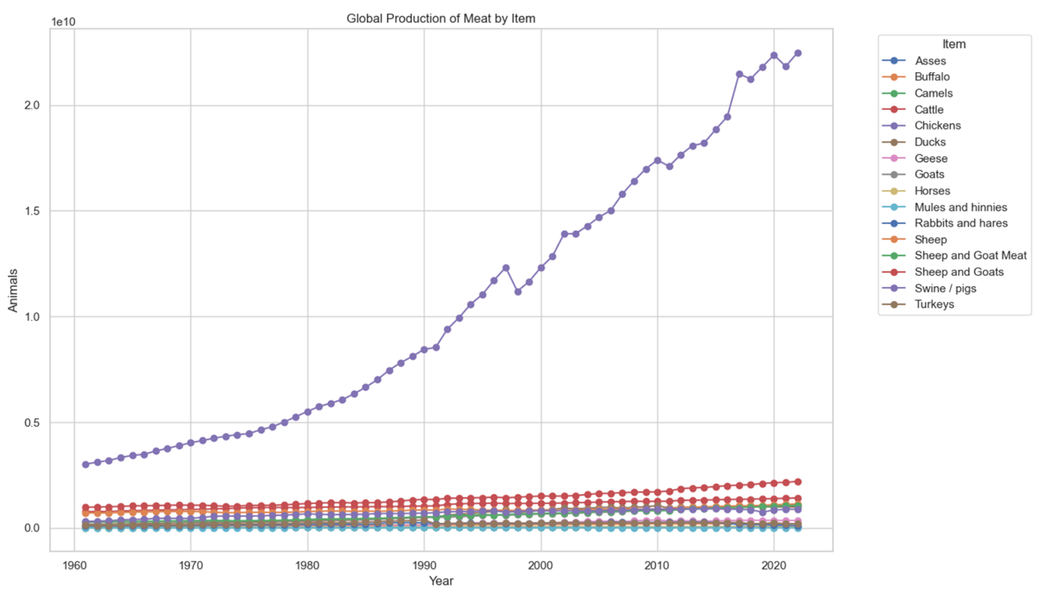
1. How has the production of major agricultural products (e.g., meat, vegetables, grains) evolved over time?
Detailed Observations:
Subsets within the meat category were further analyzed due to the high production values observed. Chicken production dwarfed all other meat production categories, showing nearly exponential growth, while other meats like beef and pork exhibited minimal growth. Sheep and goat production experienced slight increases, highlighting regional preferences and production challenges.

Slide 10
1. How has the production of major agricultural products (e.g., meat, vegetables, grains) evolved over time?
Implications:
The significant rise in chicken production suggests a shift in global consumption patterns, with potential implications for land use, feed supply chains, and environmental impact.
The modest growth in other food categories may signal constraints in agricultural innovation, regional differences in dietary preferences, or production limitations that could impact food security if not addressed.

Slide 11
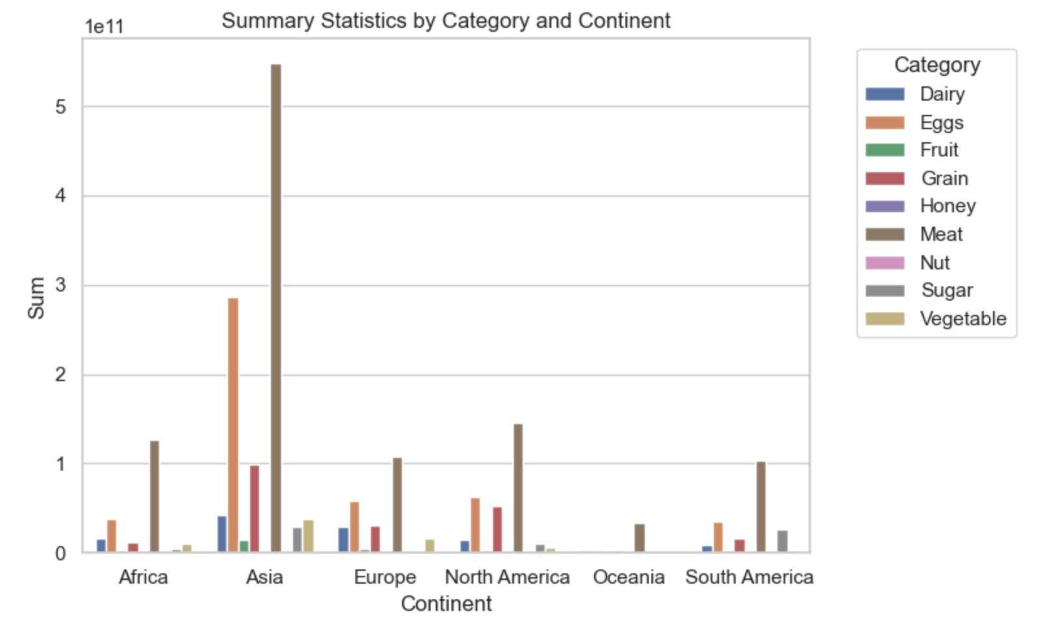
2. How does agricultural production vary across different countries and continents?
Key Findings:
Continental Variations: While meat and egg production are dominant across all continents, other agricultural outputs vary significantly. For example, North America and South America exhibit strong production in grains, particularly corn and soybeans, due to favorable climate conditions and advanced farming technologies. In contrast, Asia shows a diverse production landscape, with high outputs in rice, vegetables, and seafood, driven by regional dietary preferences and intensive farming practices.
Country-Level Differences: When analyzing production at the country level, substantial variations become evident. For instance, Brazil and the United States are major producers of beef, while European countries show a preference for dairy and pork production. African countries demonstrate a diverse range of production, often driven by local needs and less mechanized farming methods, leading to lower overall outputs compared to more industrialized nations.
Production Concentration: A deeper breakdown of the data, focusing on the top five items within each agricultural category, reveals that production is highly concentrated in a few commodities. For instance, wheat, rice, and maize dominate grain production worldwide, while fruits and vegetables show more regional specialization, with tropical fruits prevalent in Latin America and Southeast Asia.

Slide 12
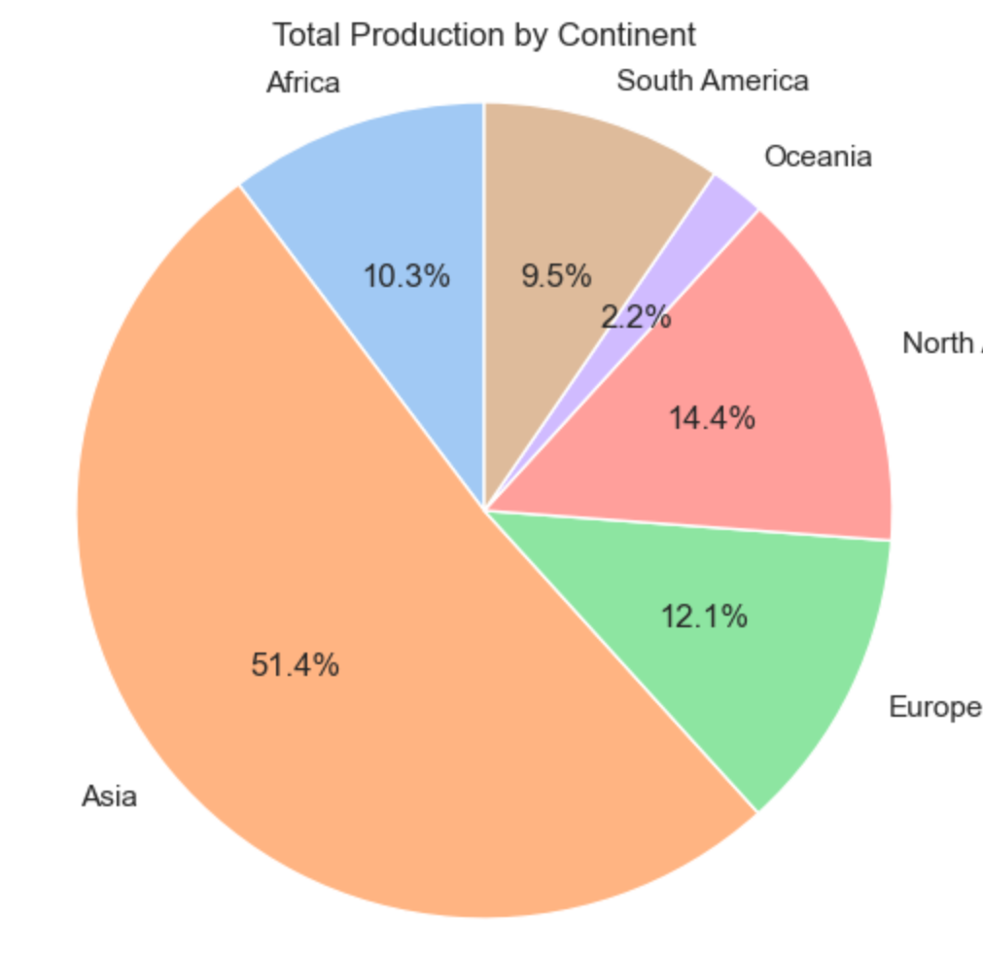
2. How does agricultural production vary across different countries and continents?
Implications:
The variations in agricultural production highlight the influence of regional climate, soil conditions, cultural dietary habits, and levels of technological advancement on food production patterns. Understanding these differences is essential for developing targeted agricultural policies and international trade strategies.
The concentration in specific commodities, particularly chicken and grains, points to potential vulnerabilities in the global food system, as shifts in demand, disease outbreaks, or climate impacts could disproportionately affect these key sectors.
Further research is recommended to explore the drivers behind these production patterns, including economic factors, policy impacts, and the role of international trade in shaping agricultural outputs across regions.

Slide 13
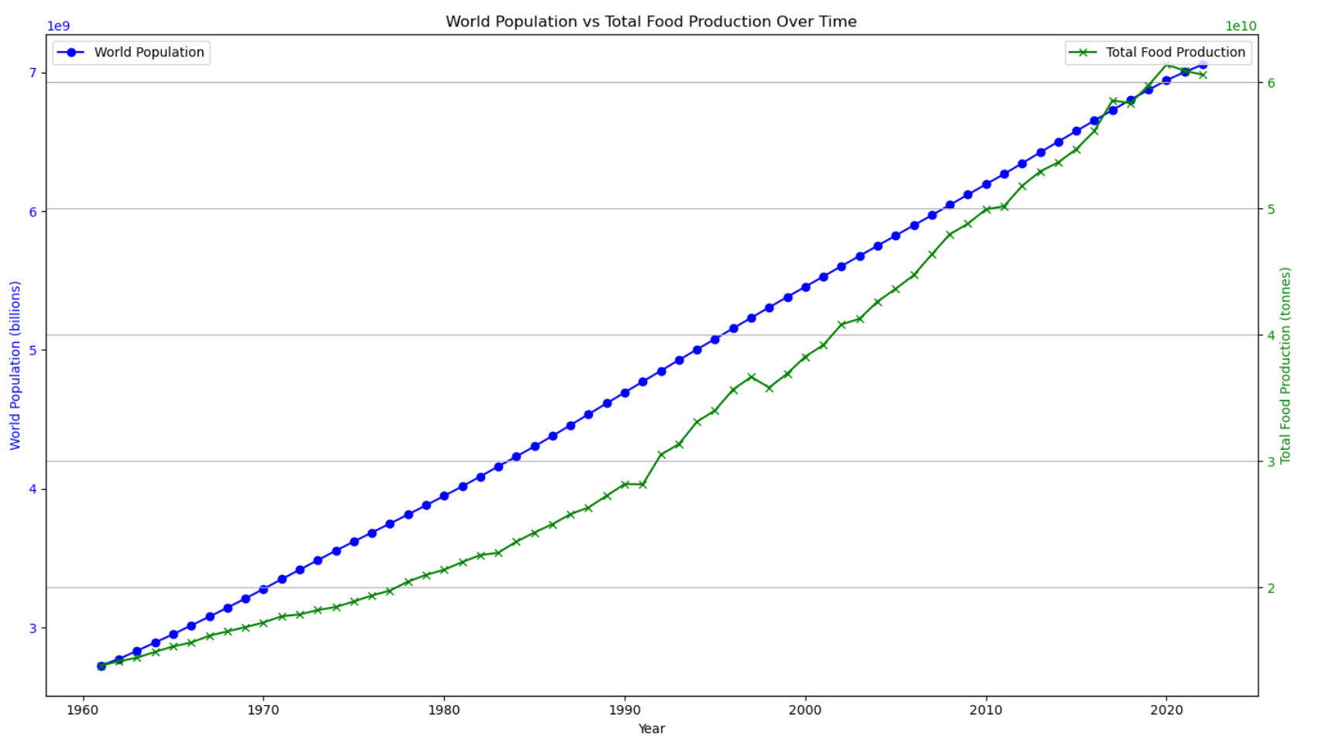
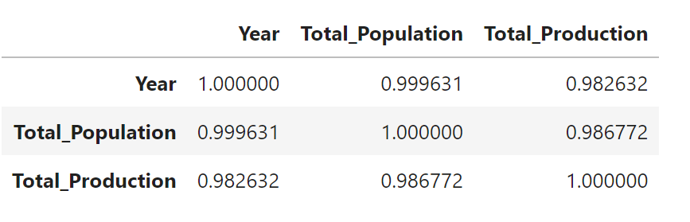
3. What trends can be observed in the relationship between agricultural production and population growth?
Key Findings:
Correlation Analysis: The statistical analysis confirmed a strong linear relationship between agricultural production and population growth. The Pearson correlation coefficient was calculated at 0.987, indicating a near-perfect linear relationship, while the Spearman correlation coefficient was 0.999, reinforcing the strong monotonic relationship between these variables.
Production vs. Population Growth Trends: From the 1960s, agricultural production closely tracked population growth, initially maintaining an almost 1:1 ratio. However, production lagged slightly behind population growth until approximately 2017, when it began to surpass population needs. This shift suggests that agricultural advancements, such as improved farming technologies, crop yields, and optimized supply chains, enabled production to exceed basic population demand levels temporarily.
Recent Declines: In recent years, agricultural production growth has slowed to align more closely with population growth rates, potentially indicating adjustments in response to market demands, environmental concerns, or resource constraints. This trend highlights the dynamic nature of the relationship and the need for sustainable practices to maintain this balance.

Slide 14
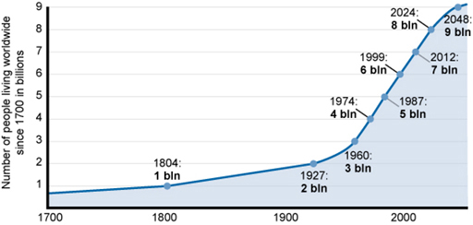
3. What trends can be observed in the relationship between agricultural production and population growth?
Implications:
The strong correlation between agricultural production and population growth underscores the critical role of agriculture in supporting global food security. However, the observed divergence in production trends post-2017 suggests potential overproduction risks or evolving consumption patterns that may require careful management to avoid resource wastage.
As global population growth is expected to slow in the coming decades, future agricultural strategies will need to pivot towards enhancing sustainability, reducing environmental impacts, and optimizing resource use rather than merely scaling up production.

Slide 15
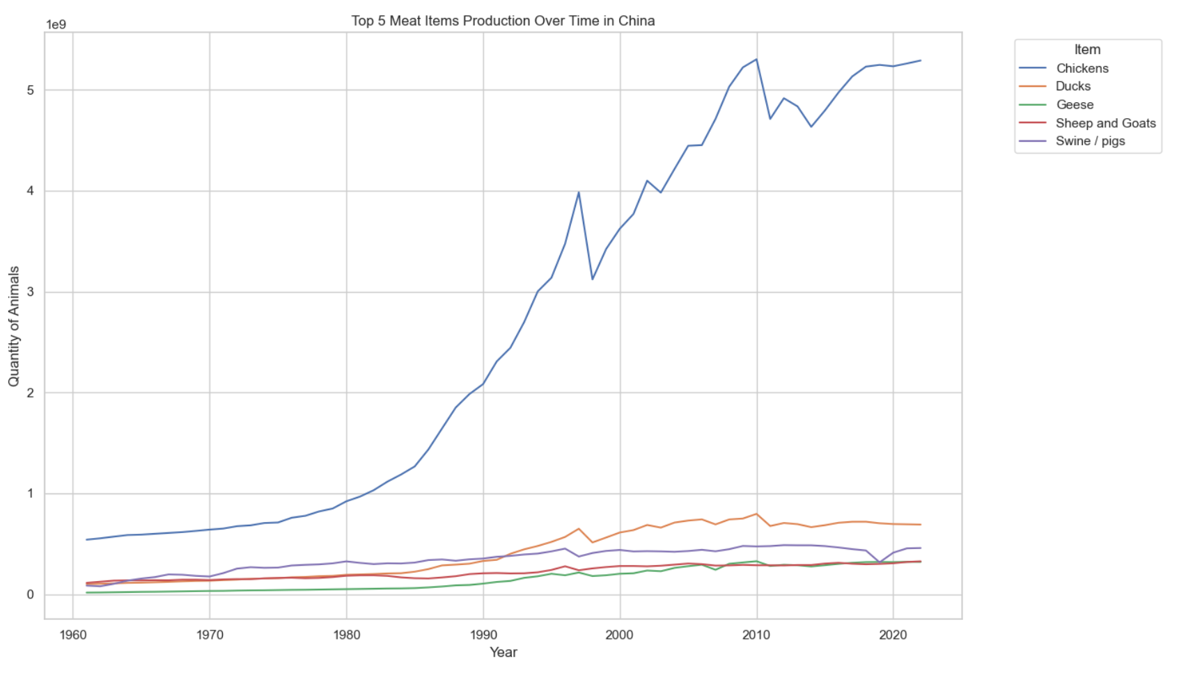
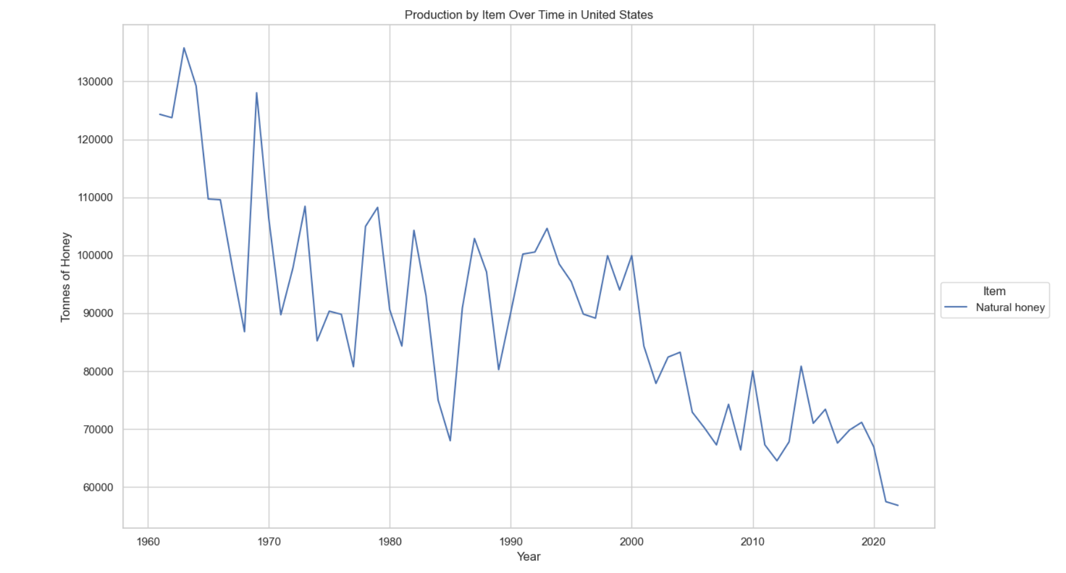
Additional Questions
Upon reviewing the data, several unexpected observations were made. First, North America emerged as a relatively small producer compared to other continents. A decline in food production was noted in Europe, raising questions about the underlying causes. An intriguing finding was that chickens are the most produced animal in nearly every country analyzed. Additionally, the U.S. exhibited a significant decline in honey production, which may be linked to the increased use of processed sugars—a trend that appears unique to the U.S. based on preliminary manual observations. These findings prompt further investigation into whether this pattern is a global phenomenon or confined to specific regions.

Slide 16
Conclusion
The analysis reveals that global agricultural production is heavily influenced by regional factors such as climate, technological advancements, and cultural dietary preferences. While meat, particularly chicken, and egg production are dominant across all continents, other agricultural outputs vary significantly, reflecting the unique environmental and economic conditions of each region. North and South America lead in grain production, driven by large-scale mechanized farming, while Asia demonstrates diversity in crop production, catering to local dietary needs. The concentration of production in a few key commodities, such as chicken, eggs, and staple grains, underscores both the strengths and vulnerabilities of the global food system. As population growth continues and environmental challenges intensify, there is a critical need for sustainable agricultural practices and policies that address these regional disparities and promote resilience in food production. Understanding these global and regional dynamics is essential for shaping future agricultural strategies that can ensure food security and adapt to changing global demands.

Slide 17
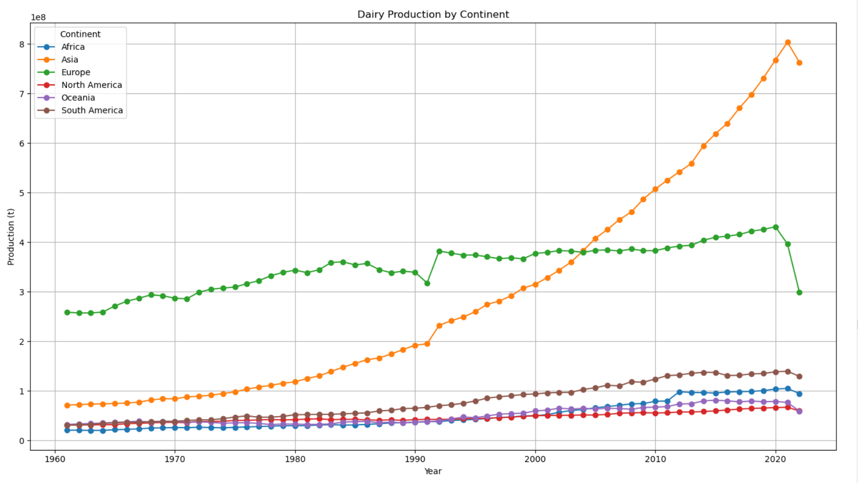
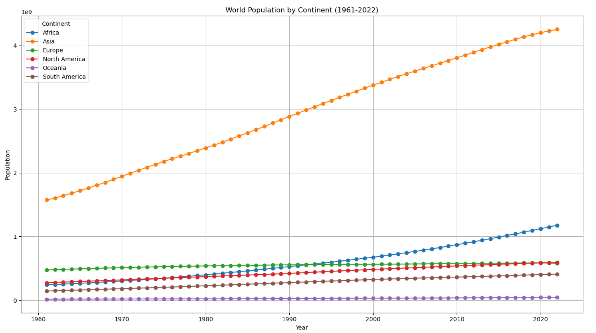

Slide 18
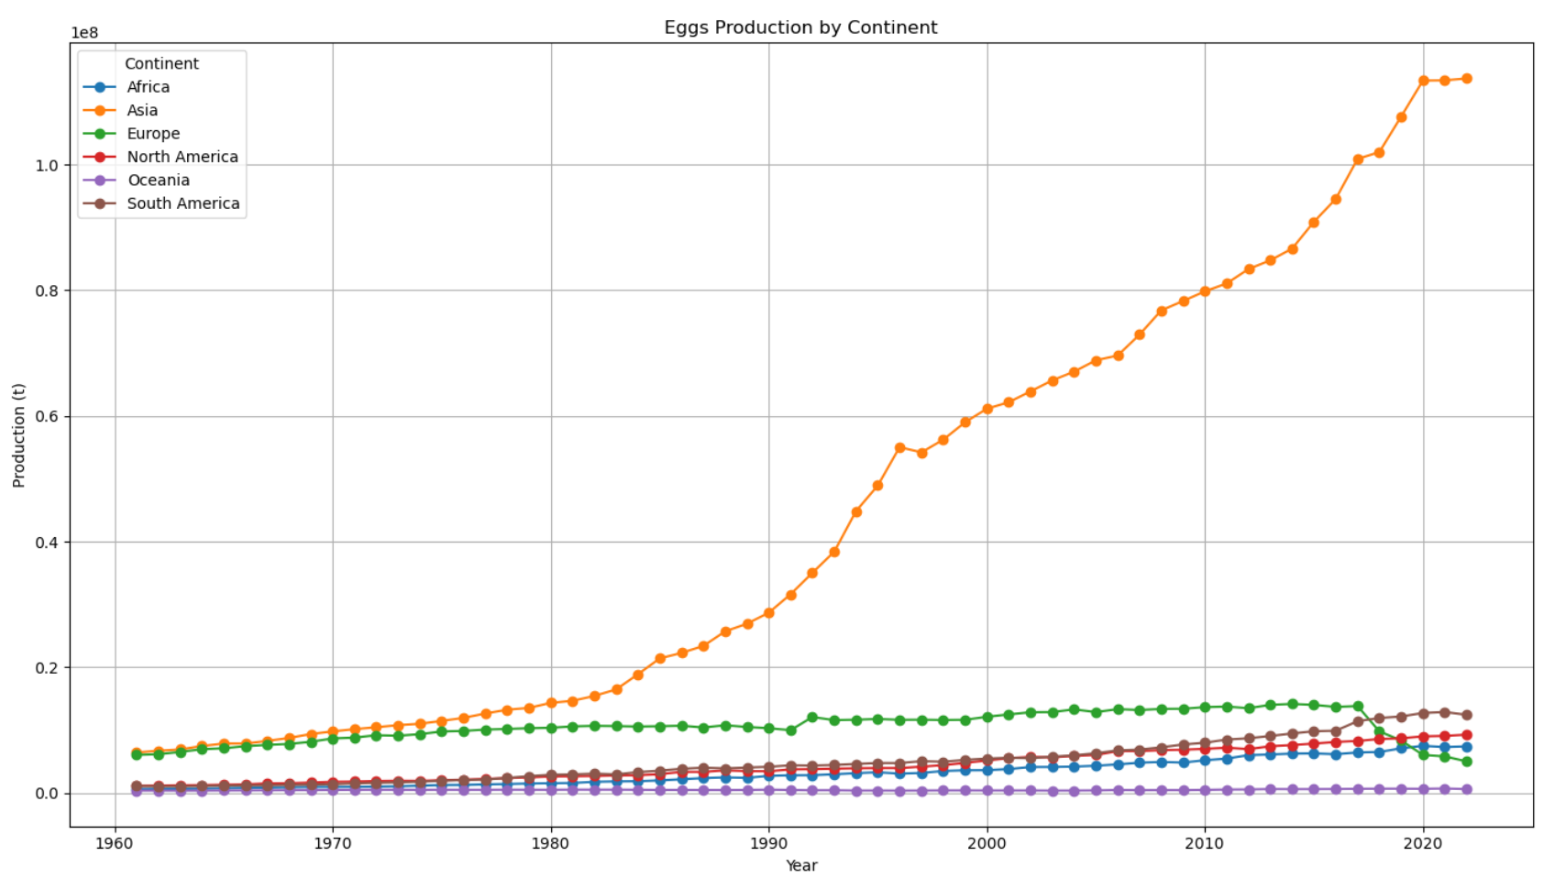

Slide 19
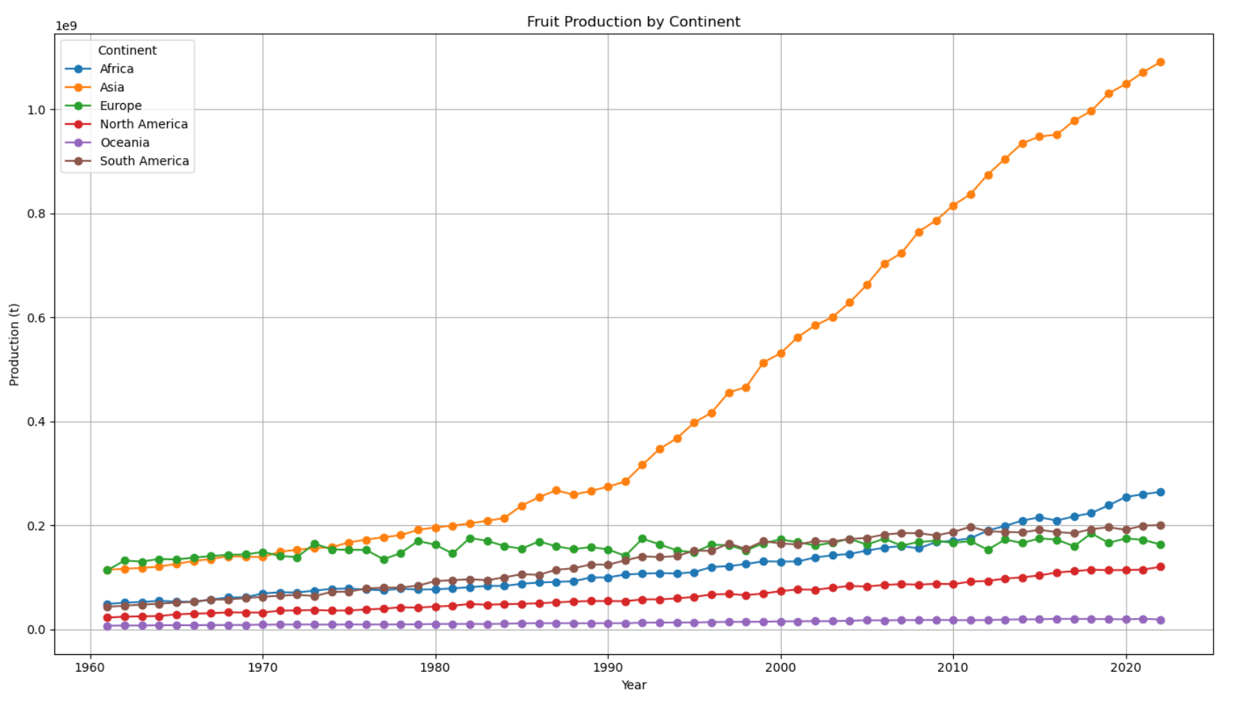

Slide 20
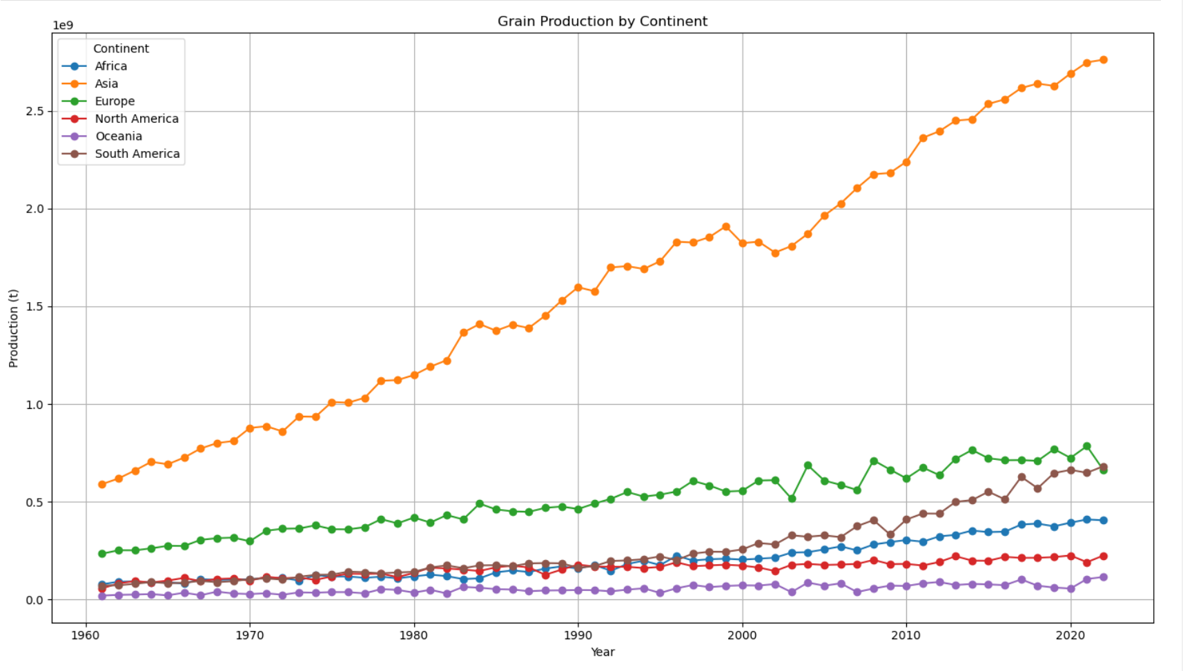

Slide 21
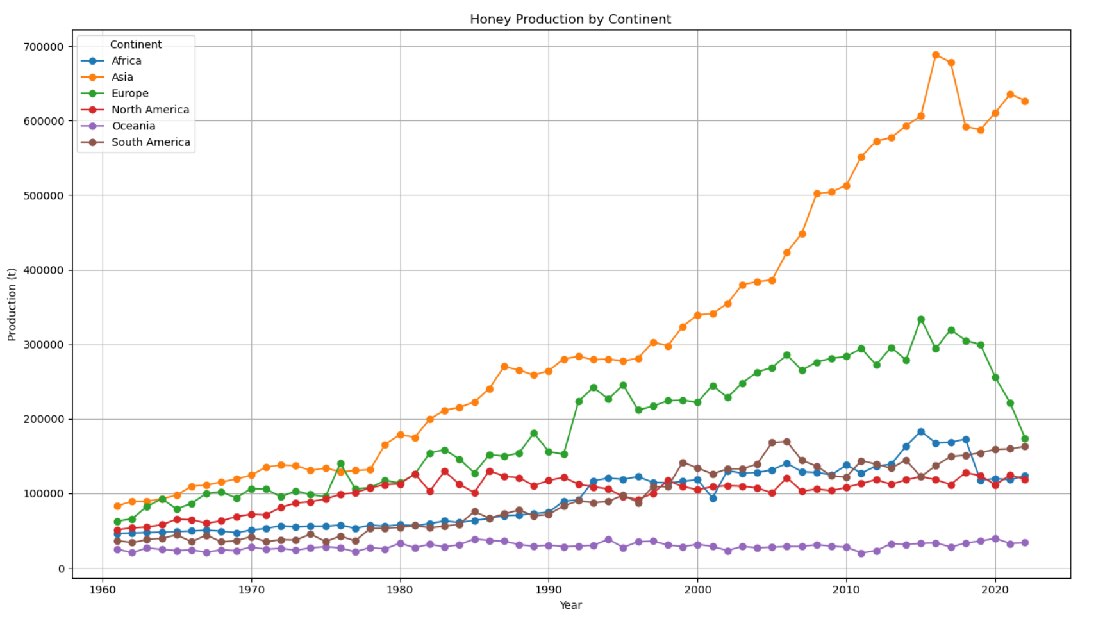

Slide 22
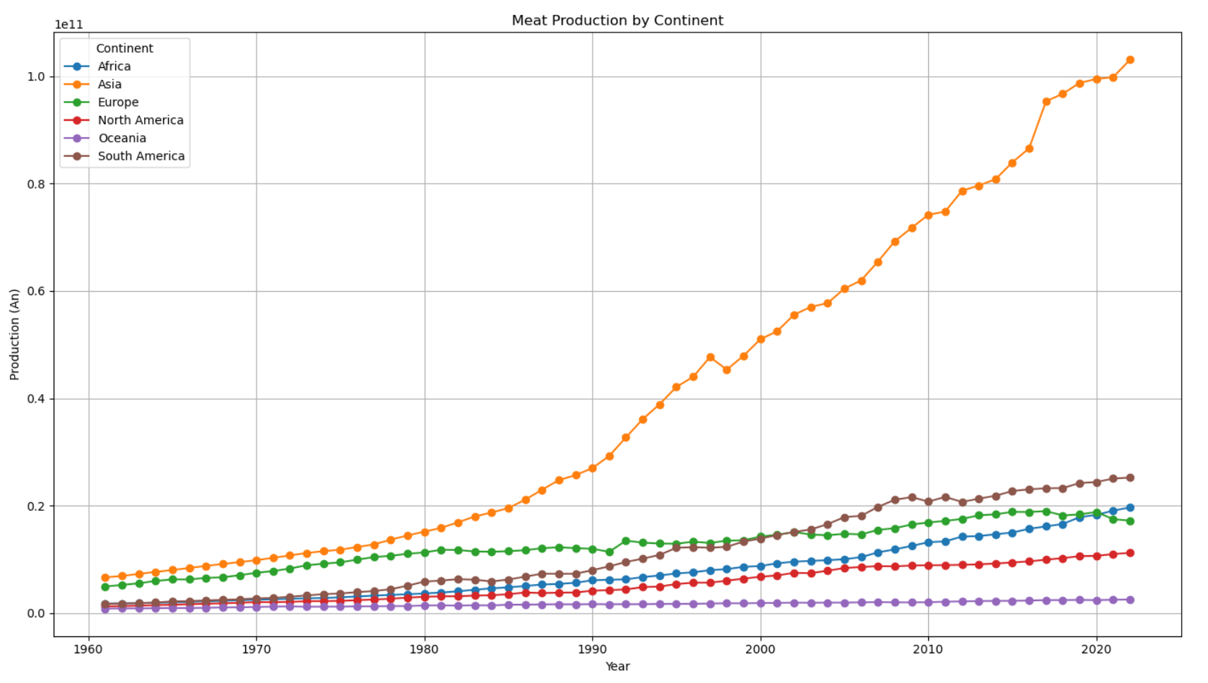

Slide 23
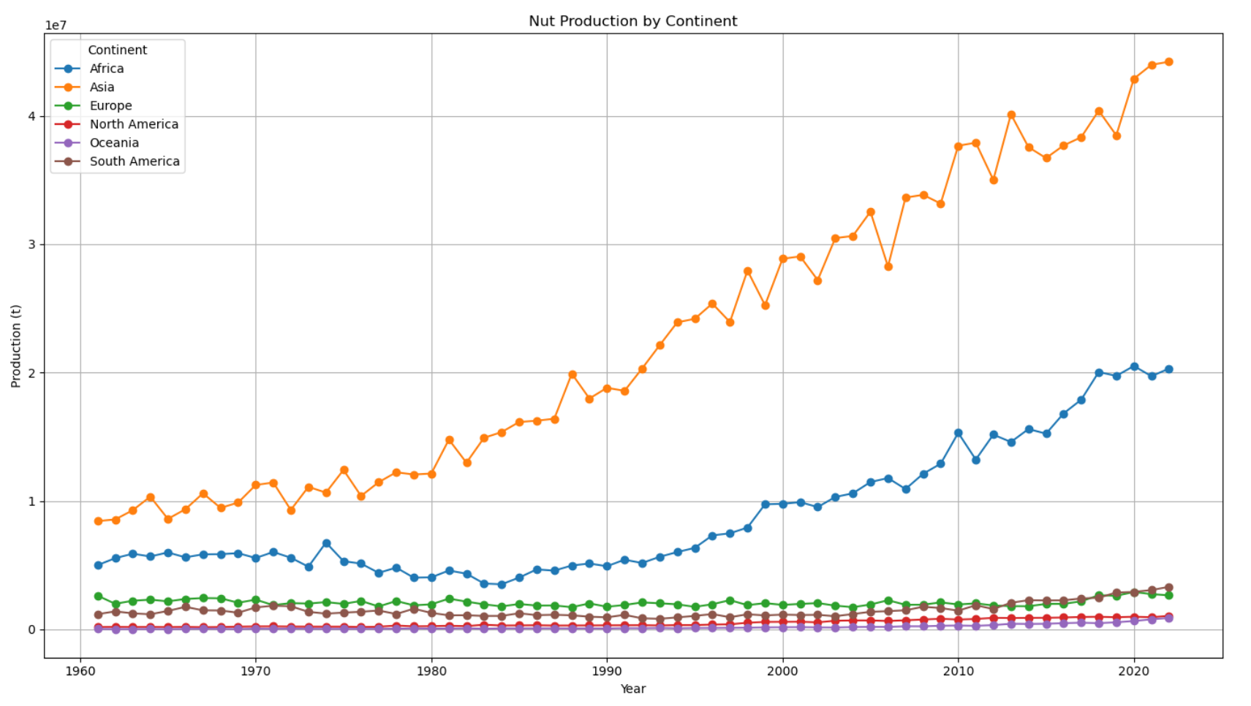

Slide 24
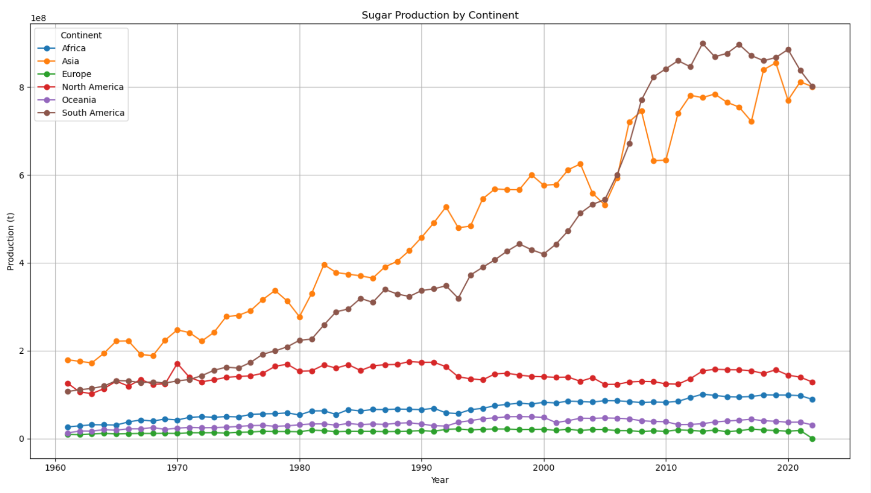

Slide 25
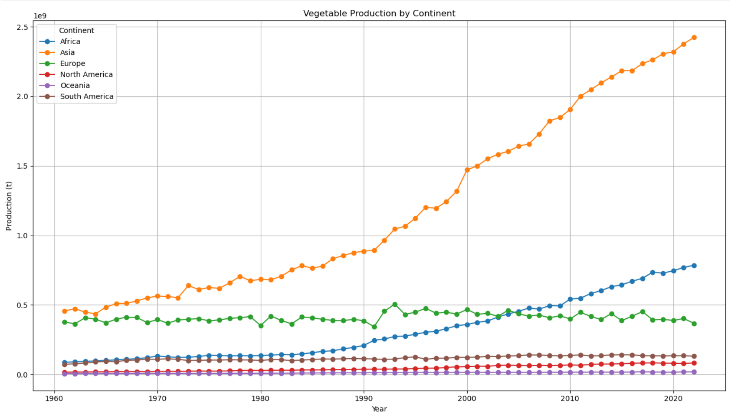

Slide 26
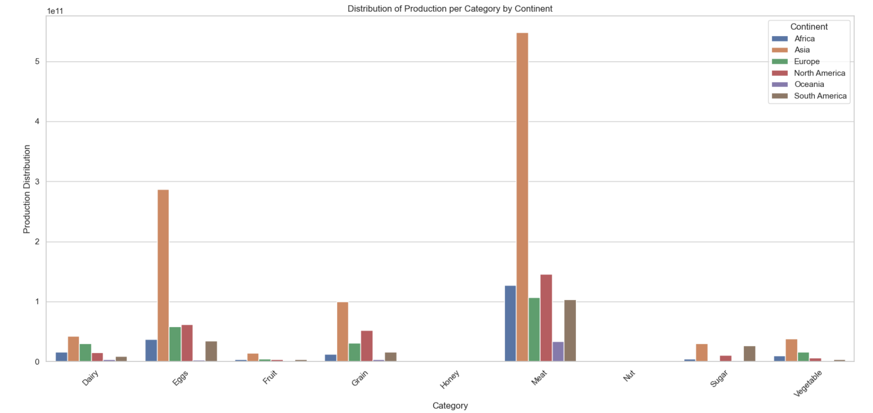
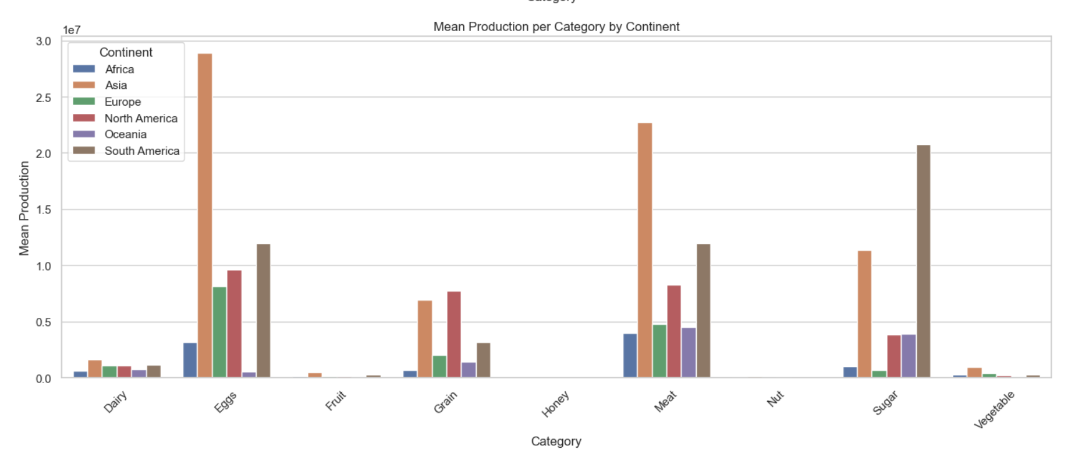
mean
sum

